Slide 1
Water Motor Automation in Agriculture
Team
K. Sankar Suresh
G. V. N. Ramu
G. V. V. S. T. Bharath
B. Hosanna
SVIET
Guide:
S.V.C.GUPTA , M. Tech, Professor

Slide 2
CONTENTS:
Introduction
Existing System
Proposed System
Apparatus and working
Advantages
Disadvantages
Conclusion

Slide 3
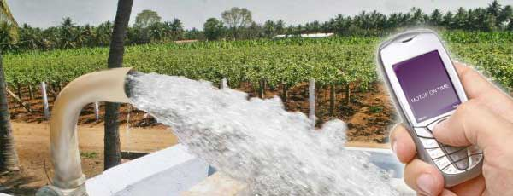
Introduction

Slide 4
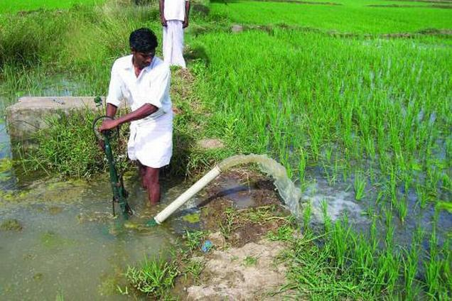
Existing System

Slide 5
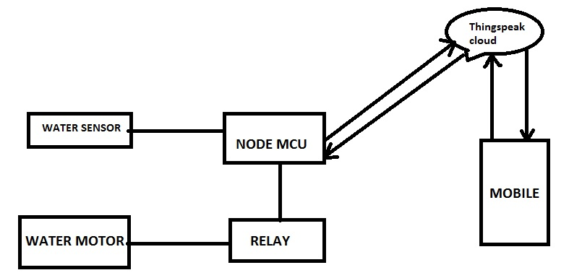
Proposed System

Slide 6
Advantages
Keeps motor safe
Saves electricity
Notifies user about lack of water
Automates water pumping in agriculture
Remote ON and OFF
By database analysis we can predict the water need and usage ahead.
Helps government to take necessary steps

Slide 7

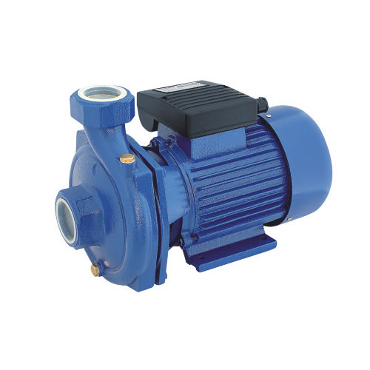


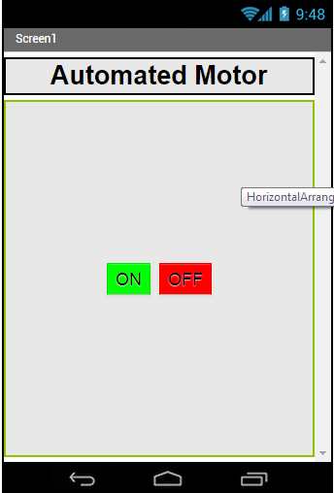
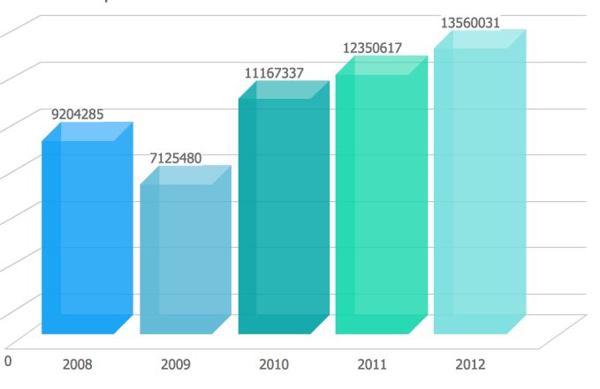
Advantages

Slide 8
Conclusion
Keeps motor safe.
Saves electricity.
Notifies user about lack of water.
Automates water pumping in agriculture.
Remote ON and OFF.

Slide 9
REFERENCES:
INSTRUCTABLES
http://www.instructables.com/id/liquid-level-sensor-tutorial/
ARDUINO
https://www.arduino.cc/
THINGSPEAK
https://www.thingspeak.com/
ELPROCUS
https://www.elprocus.com/basics-and-structure-of-embedded-c-program-with-examples-for-beginners/

Slide 10


Slide 11


